Slide 1
Marie Simulator Instructions

Slide 2
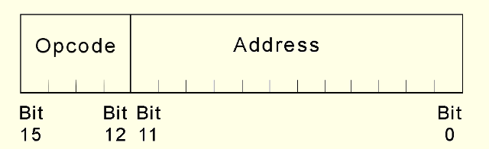
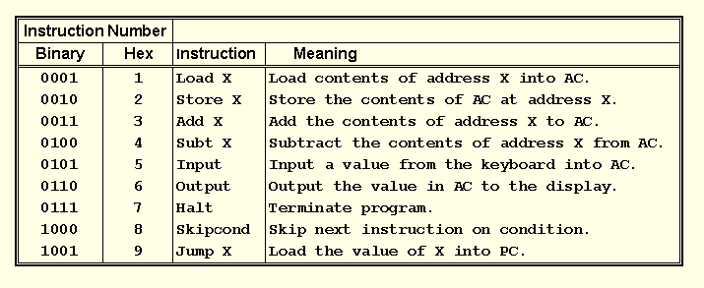
This is the format
of a MARIE instruction:
The fundamental MARIE instructions are:

Slide 3
Type | Instruction | Hex Opcode | Summary
Arithmetic | Add X | 3 | Adds value in AC at address X into AC, AC ← AC + X
 | Subt X | 4 | Subtracts value in AC at address X into AC, AC ← AC - X
 | AddI X | B | Add Indirect: Use the value at X as address of the data to add to AC
 | Clear | A | AC ← 0
Data Transfer | Load X | 1 | Loads Contents of Address X into AC
 | Store X | 2 | Stores Contents of AC into Address X
I/O | Input | 5 | Request user to input a value
 | Output | 6 | Prints value from AC
Branch | Jump X | 9 | Jumps to Address X
 | Skipcond | 8 | Skips the next instruction based on bits 11 – 10 : 000: Skips if AC < 0 400: Skips if AC = 0 800: Skips if AC > 0
Subroutine | JnS X | 0 | Jumps and Store: Stores value of PC at address X then increments PC
 | JumpI X | C | Uses the value at X as the address to jump to
Indirect Addressing | StoreI X | E | Stores value in AC at the indirect address.
 | LoadI X | D | Loads value from indirect address into AC
 | Halt | 7 | End the program

